Slide 1

DIGITAL SIGNAL PROCESSING

Slide 2

MEMBERS
Hoàng Hữu Huy – BI10-077 (30%)
Lý Anh Kiệt – BI10-092 (25%)
Phạm Hoàng Việt – BI10-192 (20%)
Phạm Đức Thắng – BI10-159 (25%)

Slide 3


AUDIO STEGANOGRAPHY
TEXT ARE EMBEDDED INTO AUDIO FILE

Slide 4

INTRODUCTION
STEGANOGRAPHY
Steganography comes from the Greek word. It means covered or secret message.
Steganography is utilized to shroud important private messages from a third party inside different innocuous messages.

Slide 5

AUDIO STEGANOGRAPHY
Audio steganography (AS) is a technique used to transmit hidden information by modifying an audio signal in an imperceptible manner.
The key to all of the methods is to exploit the Human Auditory System (HAS).

Slide 6
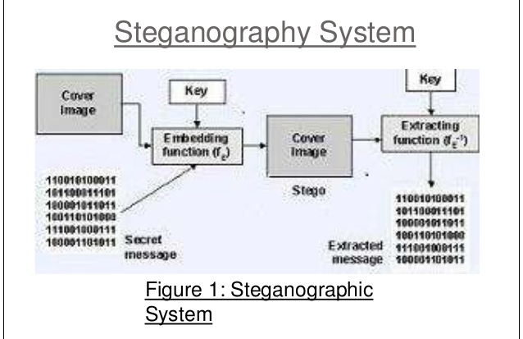
Some techniques of hiding text on audio file
Least Significant Bit (LSB) Coding
Echo Data Hiding
Parity Coding
Phase Coding
Spread Spectrum

Slide 7
LEAST SIGNIFICANT BITS
CONTENTS
1
2
3
DEFINITION
HOW IT WORKS
ADS AND DISADS

Slide 8
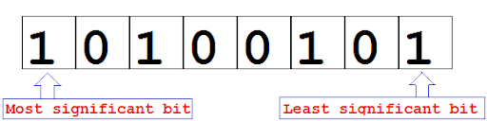
LSB

Slide 9
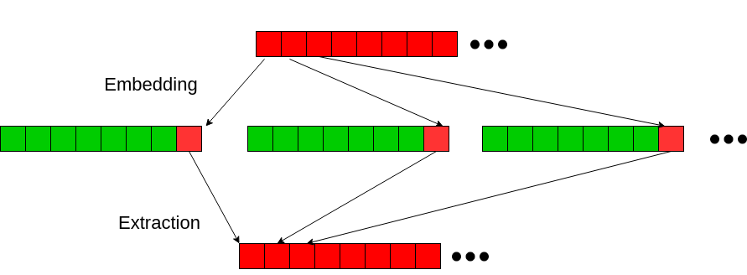
LSB ALGORITHM

Slide 10
Advantages and Disadvantages
3
2
DISADS
1
Section 3 Subtitle
ADS
It can be shown that under certain conditions, LSB embedding is not secure at all. The fatal drawback of LSB embedding is the existence of detectable artifacts in the form of pairs of values (PoVs).
Section 2 Subtitle
ADS
This strategy included security, capacity, and vigor, the three required perspectives of steganography that makes it valuable in covered up a trade of data through content reports and setting up a secret communication
Section 1 Subtitle
It results in stego-audio that contain hidden data yet appear to be of high sound fidelity.

Slide 11

DEMO
Python Code

Slide 12

THANK YOU!

